Slide 1
VACANT PARKING SPACE DETECTOR
SEPM
Using open cv Python
By:
Keerthi Kiriti Chakali(068)
Adithya Dutt K(072)
Devaditya Singh(049)

Slide 2
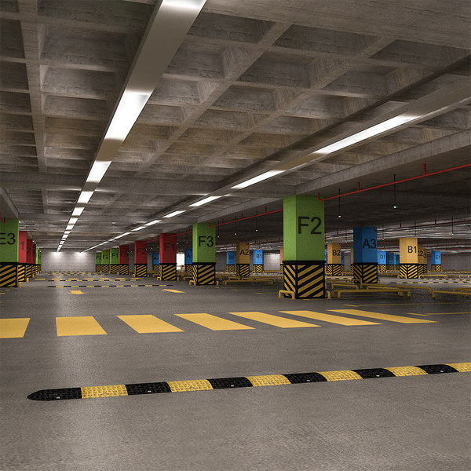
History
SEPM Project
Now a days most of the parking areas are manually managed by human manpower and there is no automatic system to manage the parking area in an efficient way. There is great analogy that when a driver enters any of the parking lot he must look for some kind of information board that tells him about the status of the parking lot that whether it is fully occupied, partly occupied or vacant. Most of the times the drivers have to circle around the parking area in search of the free parking space. This kind of problem mostly occur in cities near the shopping malls, hospitals etc., where the number of vehicles is greater as compared to the parking spaces.

Slide 3
The Project
This project aims to solve this problem by identifying empty spaces for parking
Various methods and techniques have been proposed to overcome the problem of parking in the congested areas. But they are all not pocket friendly as they need
In this Project we use image and video processing to find the empty lots and this is very cheap as it can just use the footage from the security cameras.

Slide 4
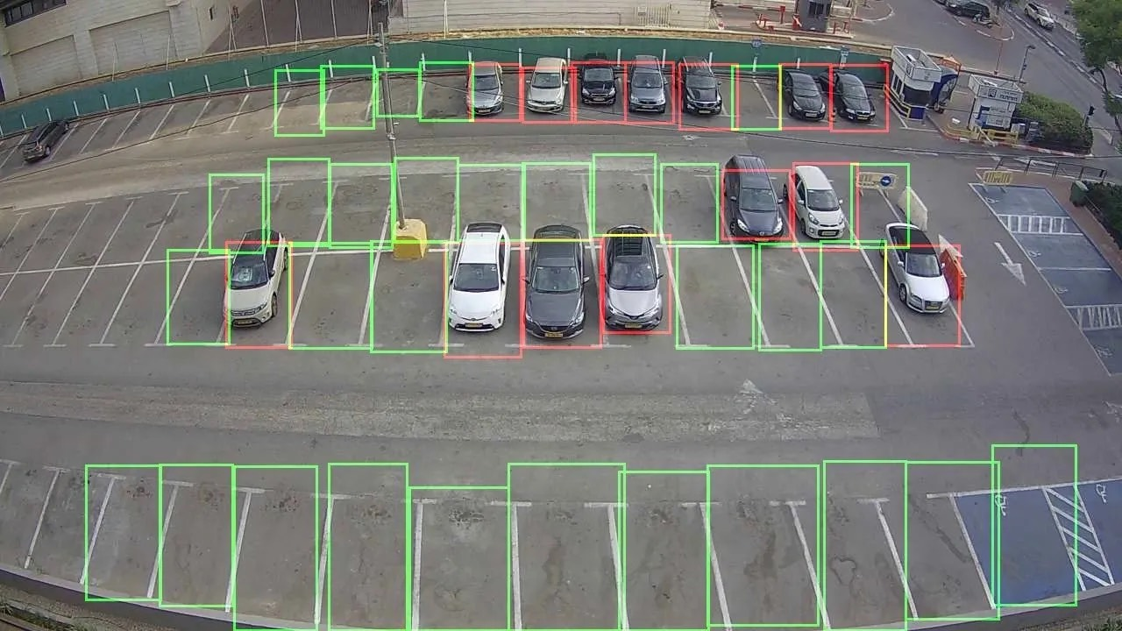
Importance
The process for searching the free parking space is time consuming and also wastage of fuel. Most of the times the parking spaces remain unoccupied, however the total occupancy is low because of bad management of parking lot. This causes ineffective use of the parking area and also results in traffic jams and congestion near the parking lots. To properly manage the parking lot and display each parking division’s information to the drivers before entering the parking lot have become an important issue to be resolved. In this paper, a system is proposed that will detect the total number of available parking spaces and displays the information to the drivers so that they can easily parked their cars. A web camera is used to get the images of the parking area and image processing techniques are used to detect the presence or absence of cars to count and locate the available parking spaces .The status of the parking lot is updated whenever a car enters or leaves the parking lot.

Slide 5
Benefits
No need of a security guard , which reduces cost.
More efficient way compared to manual checking to check the empty lot.
Reduces unnecessary traffic and makes things fast.
Updates regularly.
Increased safety as we can identify as soon as a car leaves its lot.

Slide 6
Advantages over other methods
In some methods the counting is performed by installation of the induction loop sensors under the road surface. Although the usage of sensors was less costly, not easily affected by environmental conditions and it detects accurately however, it installation was difficult and cause damage to roads. It was also difficult to maintain it in case of malfunction
The other detection methods were based on use of sensors like ultrasonic, infrared and microwave for the detection of vehicles, The disadvantage of this method was the sensors are affected by the weather conditions.
So, In comparison to the other methods this is more efficient , cheap and easy to maintain

